Slide 1
Environmental Education Goes Global!
Global Education meets Environmental Education
Presentation for the Calvert County Public Schools
Middle School Science In-service

Slide 2
Overview
Imagine a World
What is Global Education and Global Competency?
Global Environmental Education Partnerships (GEEP!) video
Examples of Global EE project ideas
Final thoughts

Slide 3
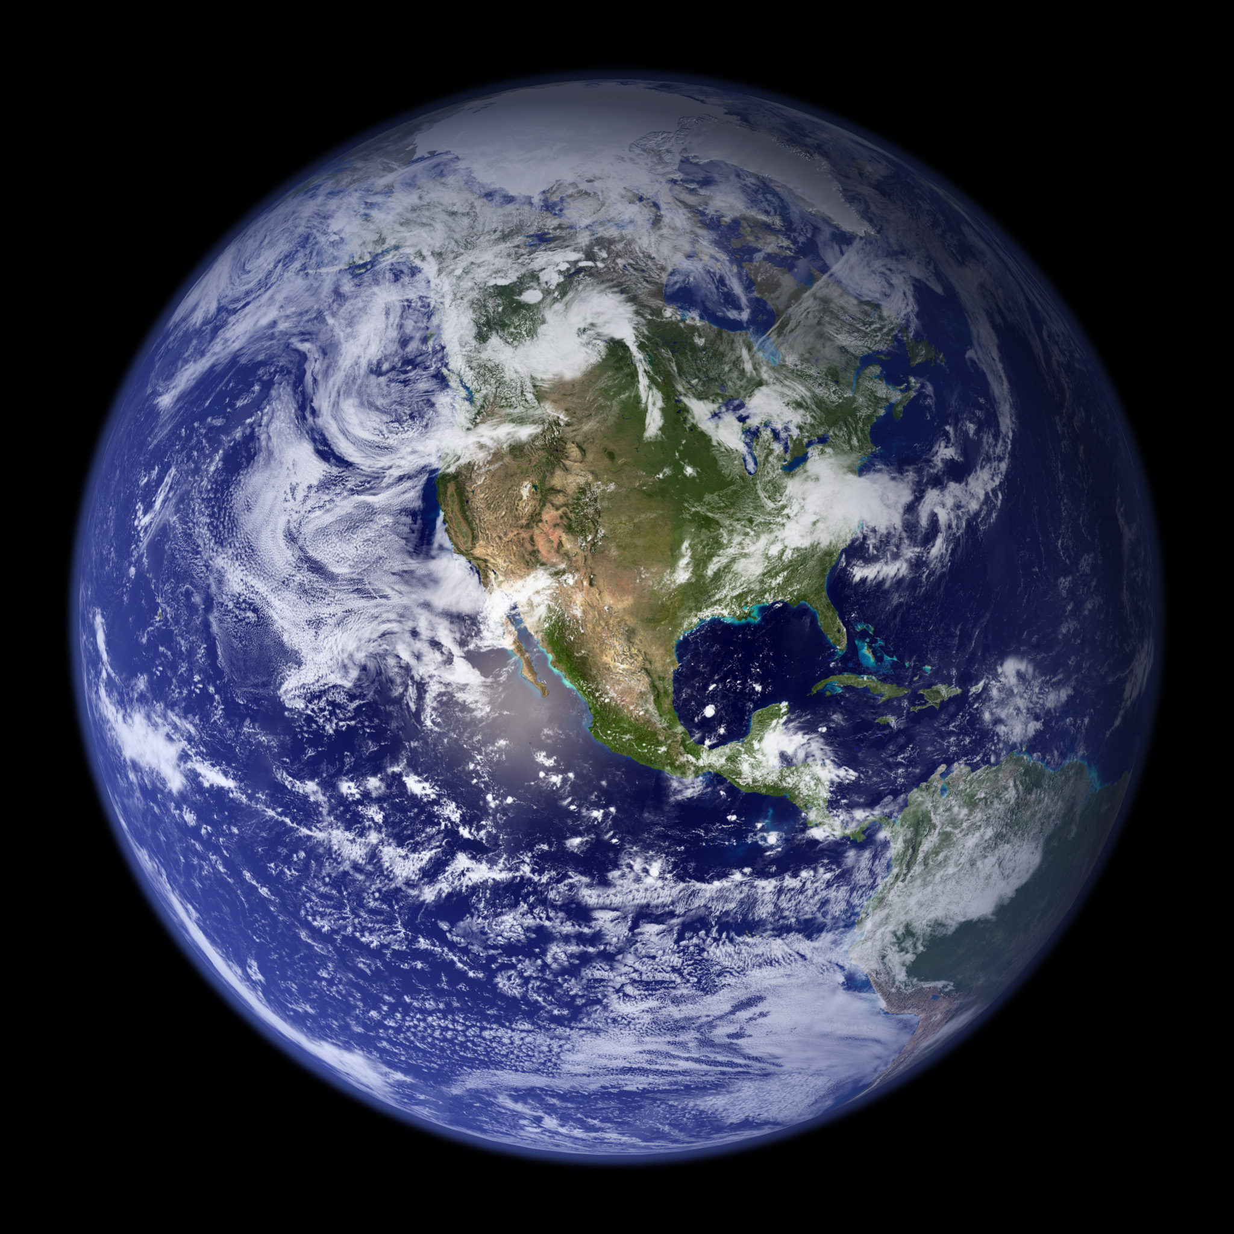
One World…
Saving our planet, lifting people out of poverty, advancing economic growth... these are one and the same fight. We must connect the dots between climate change, water scarcity, energy shortages, global health, food security and women's empowerment. Solutions to one problem must be solutions for all.
Ban Ki-moon

Slide 4
Imagine a World...
Global Education meets Environmental Education

Slide 5
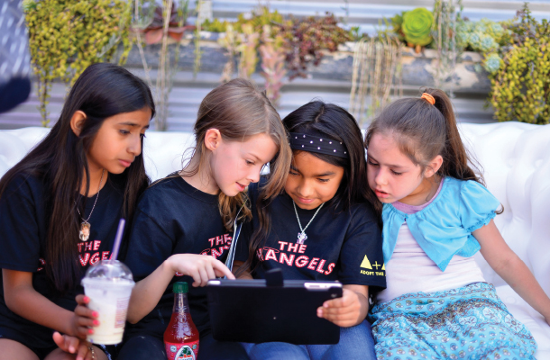
Imagine a World...
In which students dialogue with their peers on the other side of the planet or collaborate on joint projects.

Slide 6
Imagine a World...
In which students develop an understanding of perspectives from people of different cultures and places.

Slide 7
Imagine a World...
In which students truly apply an interdisciplinary approach to learning and interacting with the wider world.

Slide 8
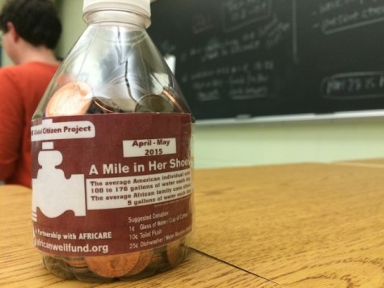
Imagine a World...
In which students turn their understanding into action to work to solve a problem in another part of the world.

Slide 9
What is Global Education?
Global Education is not a subject, but a dimension that runs through the curriculum, an extra filter to help children make sense of all the information and opinion the world is throwing at them.
Global Education develops skills and attitudes which enable people to take responsibility for their own lives and the world we live in and become active global citizens.
From the Global Teacher Project (UK)

Slide 10
Global Education
Invites inspired conversations and collaboration.
Global themes are naturally interdisciplinary
Global education invites us to keep content and themes current
Enables teachers to take risks
Can become a school-wide goal.
By guest blogger Tara Nuth Kajtaniak
Education Week February 23, 2016

Slide 11
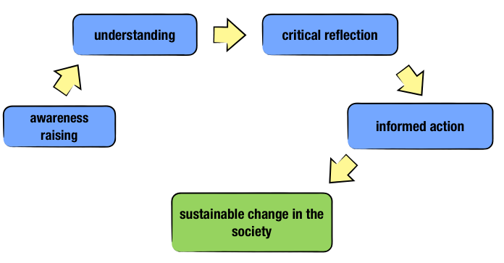
What does this look like?
From the Global Education Network

Slide 12
Globally Competent Students
Investigate the World: Students are actively engaged in learning about the world beyond their classroom and community.
Weigh Perspectives: Students develop the ability to begin to see the world as another might see it from a different nation or culture.
Communicate Ideas: with a diverse audience.
Take Action: Apply their knowledge and skills to solve a global problem.
Apply Disciplinary and Interdisciplinary Skills: Students use their learning in a variety of situations and contexts.
From Educating For Global Competence, The Asia Society

Slide 13
Global Environmental Education Partnership (GEEP)!
Global partners connecting on
environmental teaching and
learning……..

Slide 14
Examples of Global Environmental Education projects
Participate in a collaboration to conserve clean fresh water on World Water Day!

Slide 15
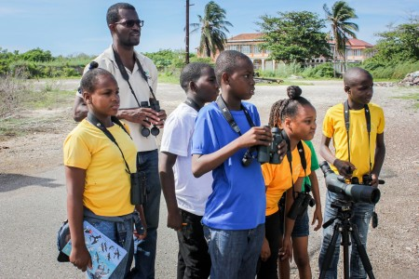
Examples of Global Environmental Education Projects
Celebrate our shared love for the migratory
songbirds that reside in both the
Northern and Southern Hemispheres.

Slide 16
Example of Global Environmental Education projects
Become aware of the impact of Global Climate Change and how to get students involved through the CLEAN network or other climate action organizations.

Slide 17
Examples of Global Environmental Education Projects
One idea would be to create a
video in the style of this
reggaeton to educate the public
about the dangers of
mosquitoes.

Slide 18
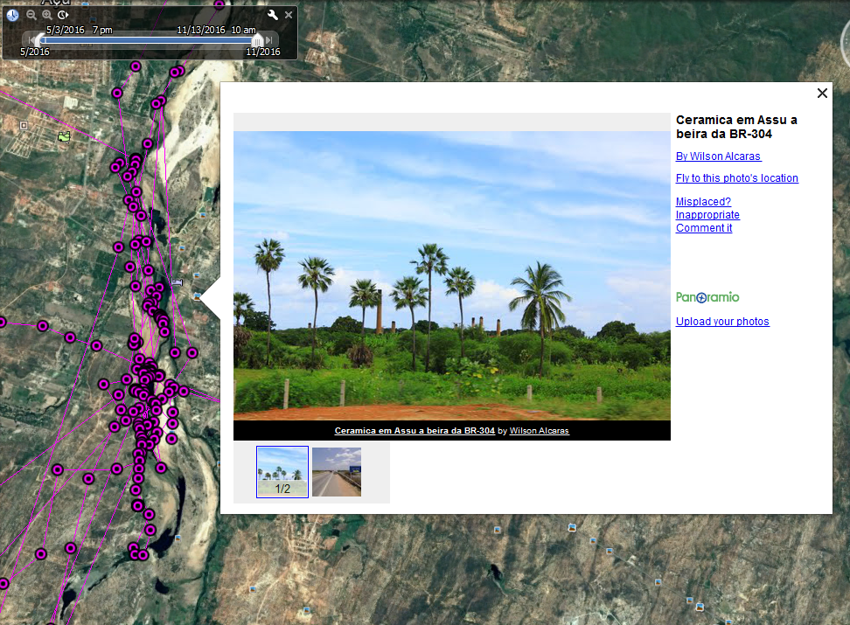
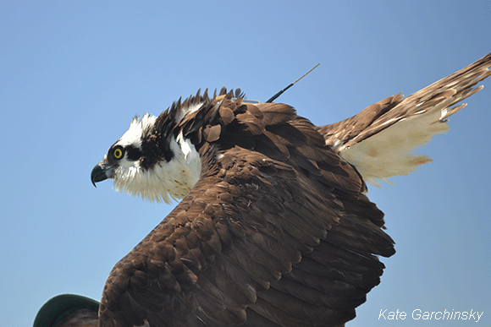
Examples of Global Environmental Education Projects
Chesapeake Bay Ospreys have been outfitted with telemetry devices. We can follow them on Google Earth and learn about their winter home (Brazil). Could we somehow connect with a nearby school?

Slide 19
Examples of Global Environmental Education Projects
Recording devices or even cell phones can be used to record local frog vocalizations. These could be shared with schools internationally as a joint study of global amphibian decline.

Slide 20
Final Thoughts
Global Education provides a wonderful opportunity to engage CCPS students to the wider world. It makes a natural connection to our environmental education program and to the traditional classroom.

